Slide 1


Ly Phat Viet Linh
19th Oct 2021

Slide 2
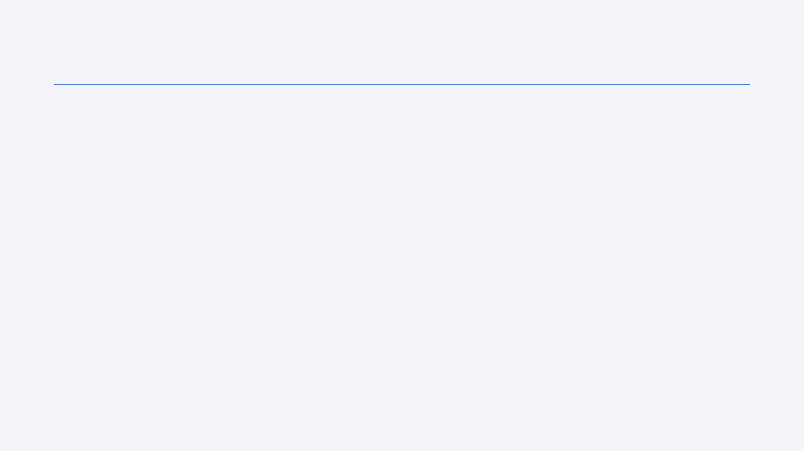
Outline
Executive Summary
Introduction
Methodology
Results
Conclusion
Appendix

Slide 3
Executive Summary
SpaceX is an American manufacturer and designr of means of transportation for space travel. Since 2008 the company has been steadily launching, orbiting and recovering spacecrafts into space.
SpaceX advertises Falcon 9 rocket launches on its website, with a cost of 62 million dollars; other providers cost upward of 165 million dollars each, much of the savings is because SpaceX can reuse the first stage.
Using data science, this report aims to help SpaceX determine the landing outcome for future spacecraft launches, reducing the cost of each launch.
The report also shows insight into what aspect / property of a launch affects its landing outcome.
Notes:
Summary of methodologies
Summary of all results

Slide 4
Introduction
The report aims to determine and predict the first stage landing outcome of future rocket launch.
By determining if the first stage will land successfully, we can determine the cost of a launch. This information can be used if an alternate company wants to bid against SpaceX for a rocket launch.
The questions:
What property of a launch affects landing outcome? Is it launch site, payload range, booster version or orbit type?
Can we predict future landing outcome base on historical launch data?

Slide 5


Slide 6
Methodology
Executive Summary
Data collection methodology:
Data was collected through Space X API: Booster Version, Launch Site, Payload Data, Core Data
Perform data wrangling
Dealing with missing data
Perform exploratory data analysis (EDA) using visualization and SQL
Perform interactive visual analytics using Folium and Plotly Dash
Perform predictive analysis using classification models
4 models were built using Support Vector Machine, K Nearest Neighbor, Logistic Regression, and Decision Tree
Hyperparameters tuning with GridSearch CV

Slide 7
Data Collection
The data set was collected through both SpaceX API and web scraping its Wikipedia page.
API
WEB SCRAPING
Using Request library to get data from SpaceX API
Collect Falcon 9 historical launch from Wikipedia
Notes:
Describe how data sets were collected.
You need to present your data collection process use key phrases and flowcharts

Slide 8
Data Collection – SpaceX API
GET DATA FROM API
NORMALIZE JSON
Get BOOSTER VERSION
GET PAYLOAD DATA
GET CORE DATA
Present your data collection with SpaceX REST calls using key phrases and flowcharts
GITHUB link to Notebook

Slide 9
Data Collection - Scraping
Request the Wiki page
Create a request object
Create Beautiful Soup object for scraping
Extracting Column Names
Find all “table”
Iterate through each header to get the column names
Create DataFrame
Iterate through each row to parse data
Append data to respective column in dataframe
GITHUB URL to Notebook

Slide 10
Data Wrangling
Describe how data were processed
You need to present your data wrangling process using key phrases and flowcharts
GITHUB URL to Notebook
PAYLOAD MASS
Null values: 5
Replaced with Mean
Landing Pad
Null values: 26
Retain nulls
Landing Outcome
Categorical
Boolean

Slide 11
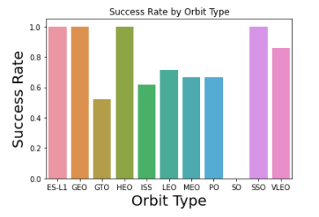
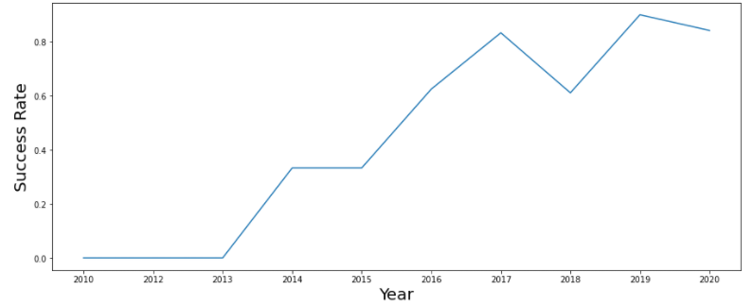
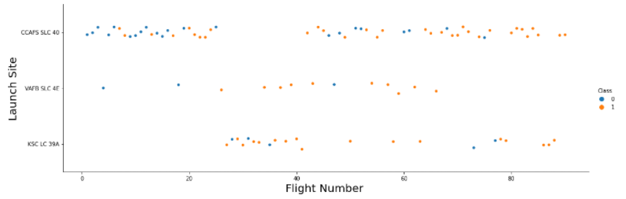
EDA with Data Visualization
Scatter plots were plotted between Flight Number, Launch Site, Payload Mass, to try find the patterns between these 3 features with launch outcome.
Bar chart classify success rate of launches between orbit type.
Line chart show success rate trend over the years
GITHUB URL to Notebook

Slide 12
EDA with SQL
Exploratory Data Analysis with SQL:
Display unique launch sites
Display 5 records where launch sites begin with the string 'CCA’
Display the total payload mass carried by boosters launched by NASA (CRS)
Average payload mass carried by booster version F9 v1.1
List the date when the first successful landing outcome in ground pad was acheived.
List the names of the boosters which have success in drone ship and have payload mass greater than 4000 but less than 6000
List the total number of successful and failure mission outcomes
List the names of the booster_versions which have carried the maximum payload mass. Use a subquery
List the failed landing_outcomes in drone ship, their booster versions, and launch site names for in year 2015
Rank the count of landing outcomes (such as Failure (drone ship) or Success (ground pad)) between the date 2010-06-04 and 2017-03-20, in descending order
GITHUB URL to Notebook
Notes:
Using bullet point format, summarize the SQL queries you performed
Add the GitHub URL of your completed EDA with SQL notebook, as an external reference and peer-review purpose

Slide 13
Build an Interactive Map with Folium
Launch sites marker added on map
Success / failed launches of each site added on map with color code.
Marker and distance line was added from launch site CCAFS SLC-40 to nearest railway, highway and city (Melbourne) to see if launch sites were in close proximity of traffic or dense population area
GITHUB URL to Notebook (note that Folium does not get rendered by Github)

Slide 14
Build a Dashboard with Plotly Dash
Interactive pie-chart showing the launch success rate between launch sites, or within each launch site. Interactive scatter chart showing launch outcome by payload range.
Conclusions draw by visual analysing with the chart:
Which site has the largest successful launches? VAFB SLC4E 9600kg
Which site has the highest launch success rate? KSC LC39A
Which payload range(s) has the highest launch success rate? 2000 - 4000kg
Which payload range(s) has the lowest launch success rate? 6000 - 7000 kg
Which F9 Booster version (v1.0, v1.1, FT, B4, B5, etc.) has the highest launch success rate? FT
GITHUB URL to .py file and screenshots of dashboard

Slide 15
Predictive Analysis (Classification)
To predict the landing outcome for future launches, 4 predictive models were created using algorithm:
Support Vector Machine
K Nearest Neighbor
Decision Tree
Logistic Regression
GITHUB URL to Notebook
Standardize Data
(Standard Scaler)
Split Train/Test Data
GridsearchCV
Fit and Tune Hyperparameters
Model Evaluation

Slide 16
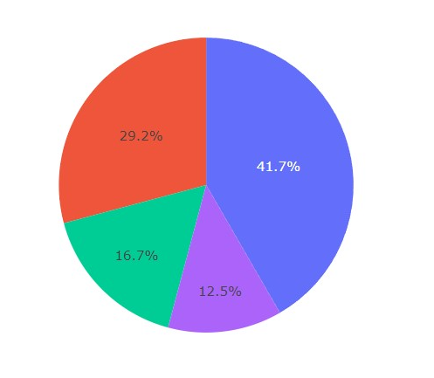
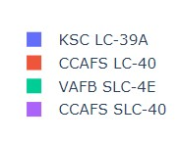
Results
Exploratory data analysis shows the success rate of a launch are affected by launch site, payload carried, orbit type and booster version.
Since 2013 the overall success rate has been increasing steadily.
4 predictive models were built and fine tuned to predict the landing outcome of future launches

Slide 17


Slide 18
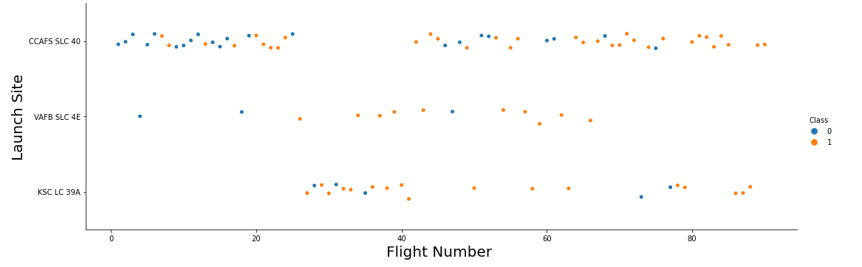
Flight Number vs. Launch Site
As we can see, the success rate seems to be increasing with Flight Number, for each Launch Site (class 1 = succeeded, class 0 = failed)
Notes:
Show a scatter plot of Flight Number vs. Launch Site
Show the screenshot of the scatter plot with explanations

Slide 19
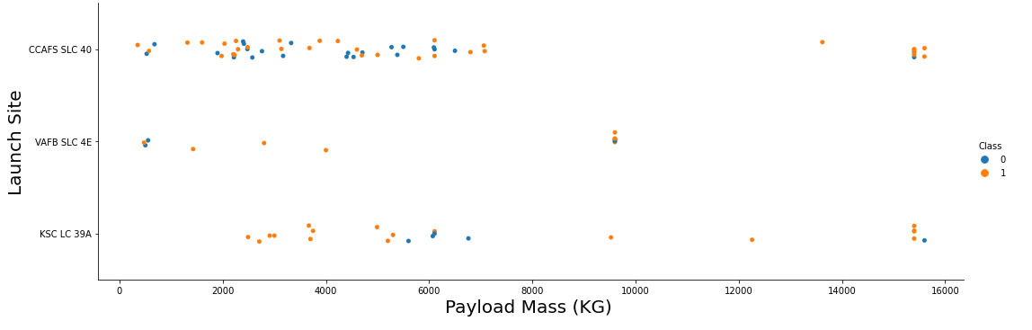
Payload vs. Launch Site
Higher payload mass launches seem to have more success rate than low payload mass launches. (class 1 = succeeded, class 0 = failed)
Notes:
Show a scatter plot of Payload vs. Launch Site
Show the screenshot of the scatter plot with explanations

Slide 20
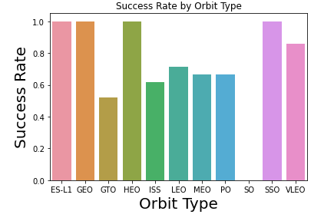
Success Rate vs. Orbit Type
Bar chart showing success rate per each orbit type.

Slide 21
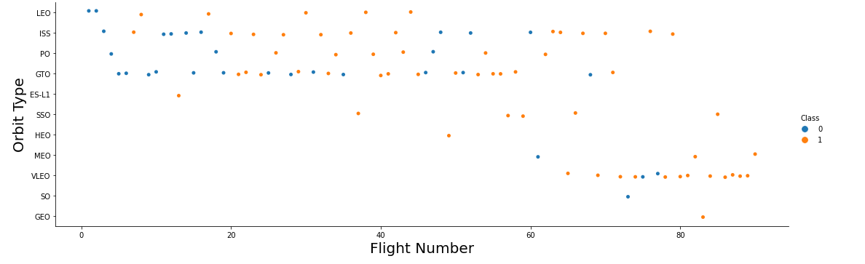
Flight Number vs. Orbit Type
With the LEO orbit the Success appears related to the number of flight
There seems to be no relationship between flight number when in GTO orbit.
Notes:
Show a scatter point of Flight number vs. Orbit type
Show the screenshot of the scatter plot with explanations

Slide 22
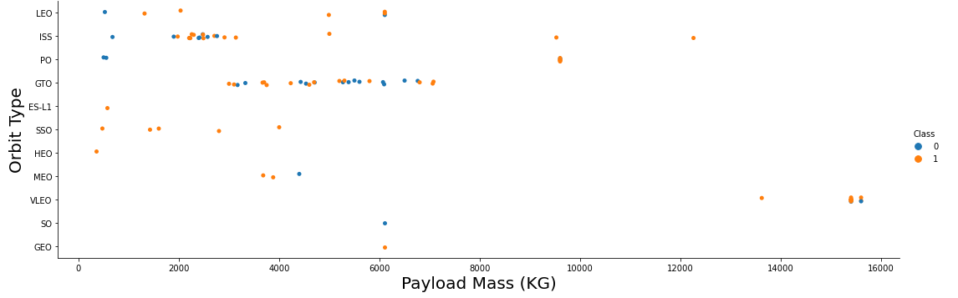
Payload vs. Orbit Type
Heavy payloads have a negative influence on GTO orbits and positive on GTO and Polar LEO (ISS) orbits. (class 1 = succeeded, class 0 = failed)
Notes:
Show a scatter point of payload vs. orbit type
Show the screenshot of the scatter plot with explanations

Slide 23
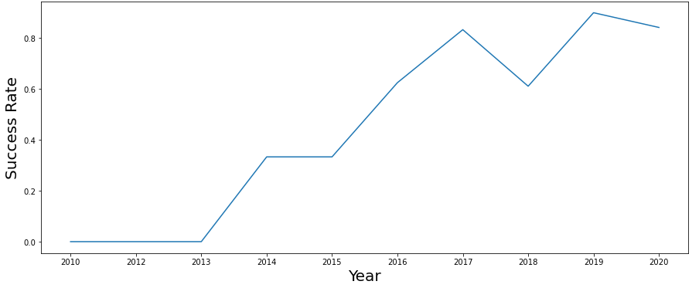
Launch Success Yearly Trend
The launch success rate improves significantly each year!

Slide 24
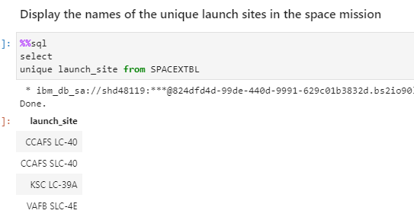
All Launch Site Names
Unique launch sites can be select with a simply query

Slide 25
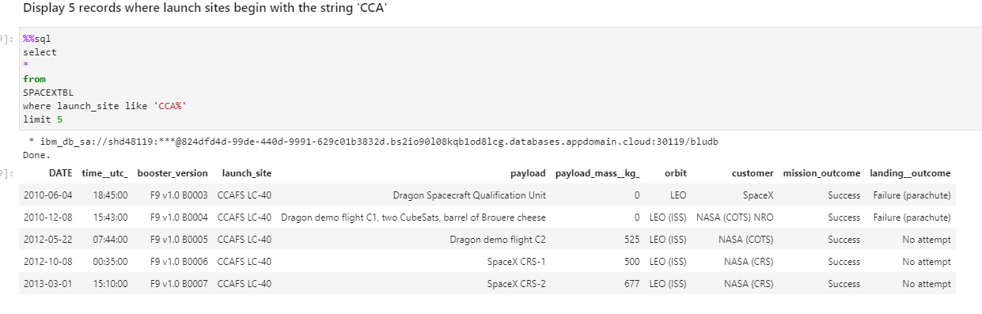
Launch Site Names Begin with 'CCA'
5 launches with launch sites begin with CCA:
Notes:
Find 5 records where launch sites begin with `CCA`
Present your query result with a short explanation here

Slide 26
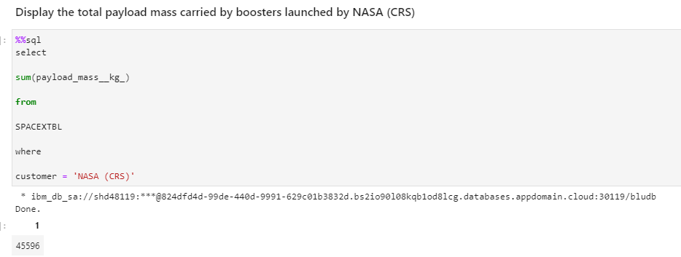
Total Payload Mass
Total payload carried by boosters from NASA: 45,596 kg

Slide 27
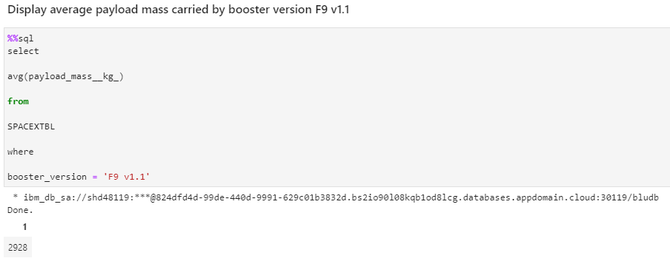
Average Payload Mass by F9 v1.1
Average payload mass carried by booster version F9 v1.1: 2,928 kg

Slide 28
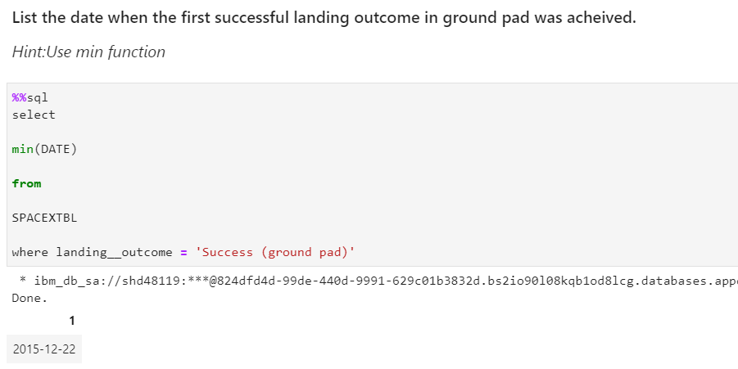
First Successful Ground Landing Date
First successful ground landing was achieved on:
22nd Dec 2015

Slide 29
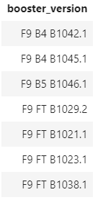
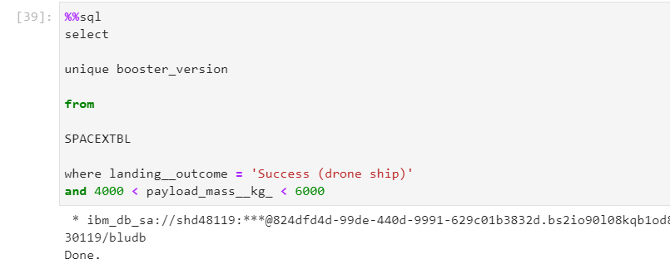
Successful Drone Ship Landing with Payload between 4000 and 6000
Boosters that have successfully landed on drone ship and had payload mass greater than 4000 but less than 6000:

Slide 30
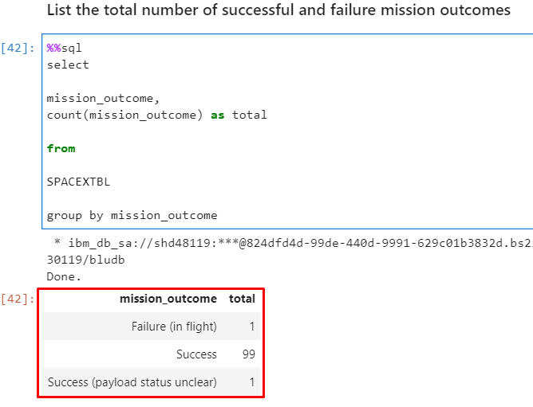
Total Number of Successful and Failure Mission Outcomes
Total number of successful versus failure mission outcomes:
100 success : 1 failure

Slide 31
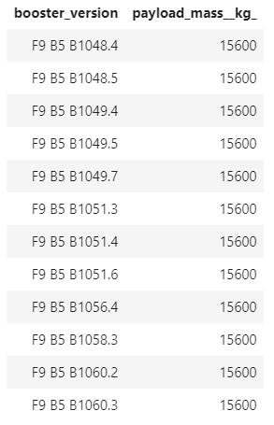
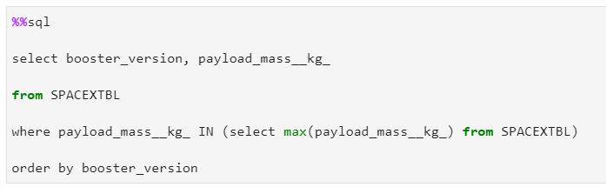
Boosters Carried Maximum Payload
Maximum payload carried: 15,600 kg
15 different booster versions have carried the maximum payload.

Slide 32
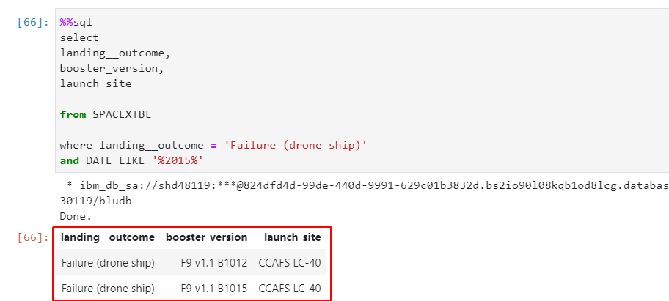
2015 Launch Records
Failed landing_outcomes in drone ship, their booster versions, and launch site names in year 2015:

Slide 33
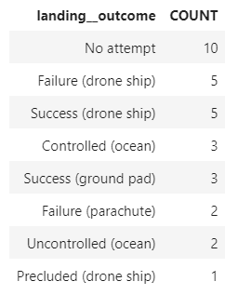
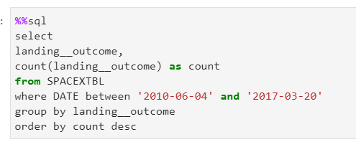
Rank Landing Outcomes Between 2010-06-04 and 2017-03-20
Number of landing outcomes between 2010-06-04 and 2017-03-20, in descending order.

Slide 34


Slide 35
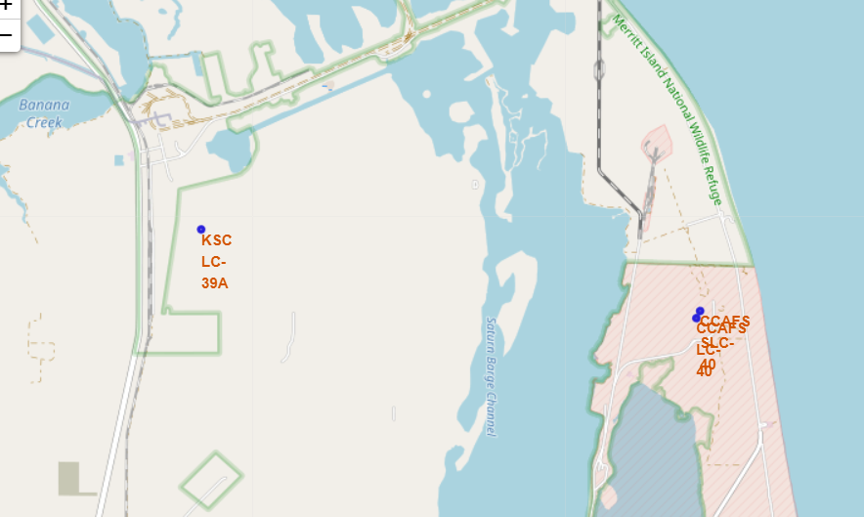
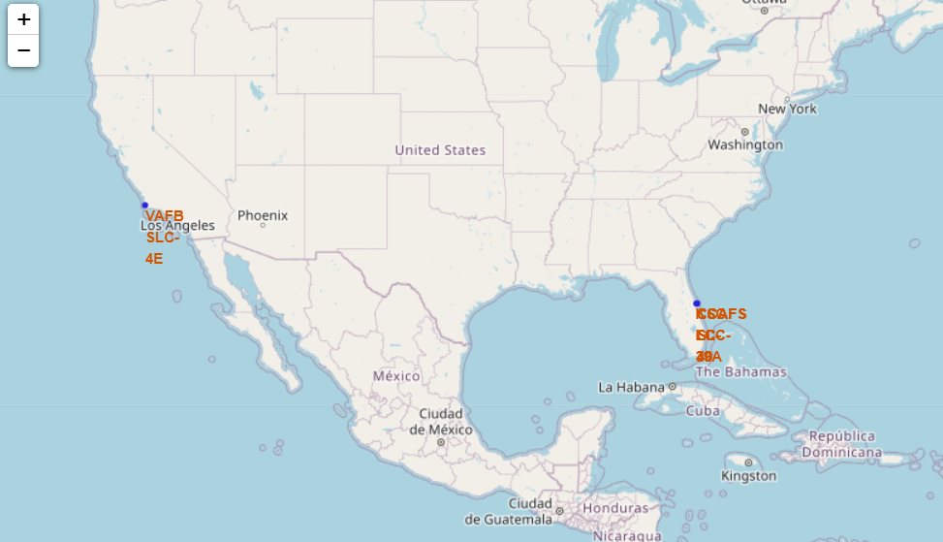
Launch Site Locations
We can see 4 launch sites are all situated on the coastline.

Slide 36
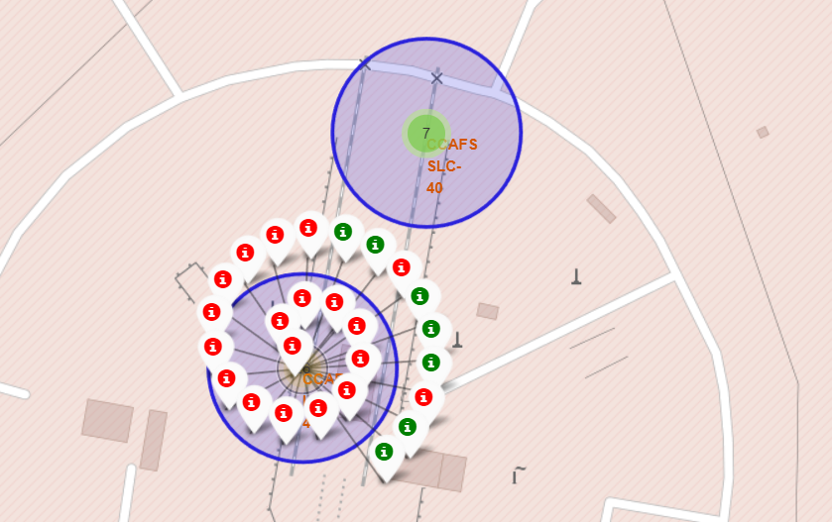
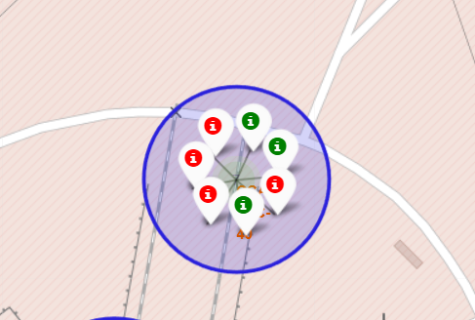
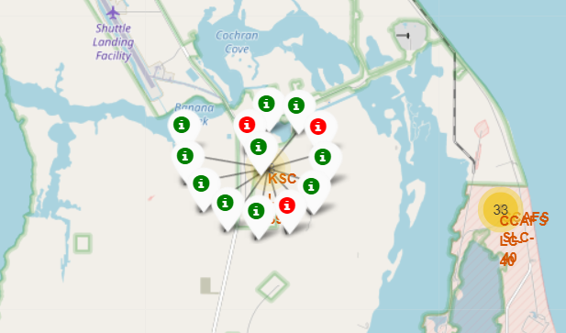
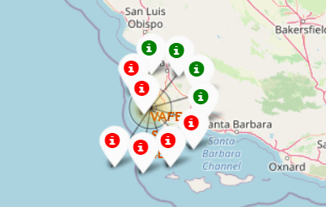
Launch Outcome By Launch Site
The KSC – LC39A Launch site has higher success rate
The CCAFS LC-40 has lower success rate
Fewer launches was done on CCAFS SLC-40 and VAFB SLC-4E
CCAFS LC-40
CCAFS SLC-40
KSC – LC39A
VAFB SLC-4E
Notes:
Replace <Folium map screenshot 2> title with an appropriate title
Explore the folium map and make a proper screenshot to show the color-labeled launch outcomes on the map
Explain the important elements and findings on the screenshot

Slide 37
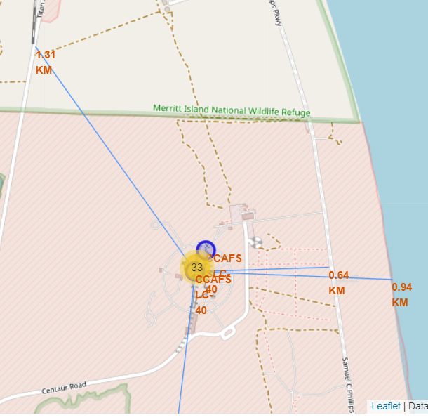
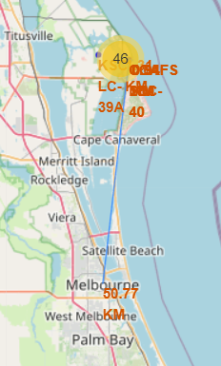
Launch Site Proximity
Launch sites are in relatively close proximity of:
Railways
Highways
Coastlines
Far away from:
Cities

Slide 38


Slide 39
Success Rate of all Launch Sites
KSC LC-39A has the highest success rate of all launch sites.
CCAFS SLC-40 has the lowest success rate of all launch sites.

Slide 40
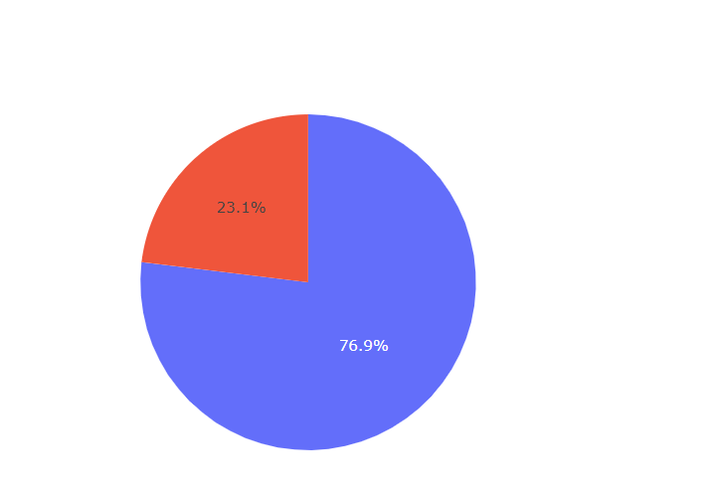
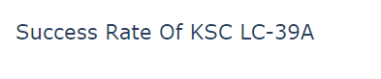
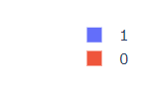
Success Launch Rate of KSC LC-39A
Class = 1 : success rate
Class = 0: failure rate
KSC LC-39A has 76.9% success launch rate.
Notes:
Replace <Dashboard screenshot 2> title with an appropriate title
Show the screenshot of the piechart for the launch site with highest launch success ratio
Explain the important elements and findings on the screenshot

Slide 41
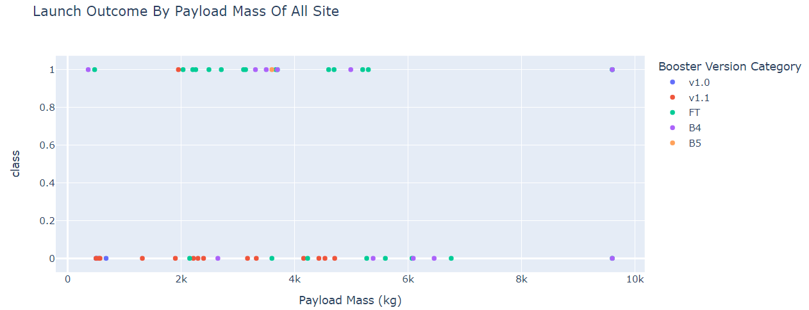
<Dashboard Screenshot 3>
Booster FT has more success launches with payload range from 2000 – 4000kg
Payload range from 6000-8000kg has no success launches.
Notes:
Replace <Dashboard screenshot 3> title with an appropriate title
Show screenshots of Payload vs. Launch Outcome scatter plot for all sites, with different payload selected in the range slider
Explain the important elements and findings on the screenshot, such as which payload range or booster version have the largest success rate, etc.

Slide 42


Slide 43
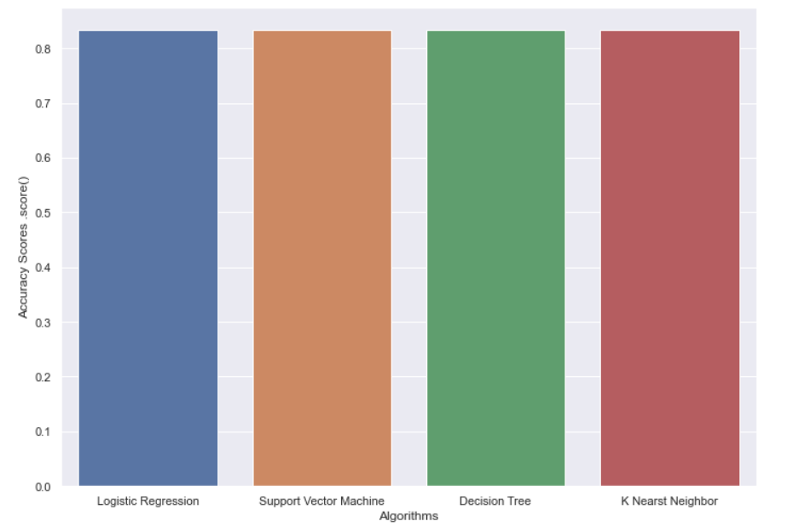
Classification Accuracy
4 models were built:
Logistic Regression
Support Vector Machine
Decision Tree
K Nearest Neighbor
The scores are practically the same: 0.83

Slide 44
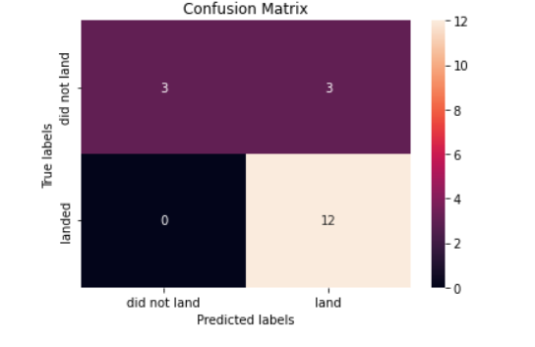
Confusion Matrix
We can see:
3 records were correctly classified as “did not land”
12 records were correctly classified as “landed”
3 records were incorrectly classified as “landed”
3 records were incorrectly classified as “did not land”

Slide 45
Conclusions
Since 2013 the overall success rate has been increasing steadily.
In terms of launch sites:
KSC LC-39A has the highest success rate of all launch sites.
CCAFS SLC-40 has the lowest success rate of all launch sites.
In terms of payload range:
Range 2000 – 4000kg has the highest success rate
Range 6000-7000kg has the lowest success rate
Booster version and orbit type’s affect on landing outcome are unconclusive, as the dataset is too small.

Slide 46


